Slide 2
Hypothesis
A hypothesis is the statement or assumption about the parameter of the population.
Once the hypothesis is formed, we must test it to decide the validity of the hypothesis whether it has to be accepted or rejected. The only information which helps us to take decision is contained in the sample. Based on the sample information, we make a decision about the population parameters.
The procedure of testing assumption or hypothesis about the population parameters on the basis of sample information to obtain the inference about the population is known as testing of hypothesis.
The main objective of hypothesis testing is to make decision whether to accept or to reject the hypothesis being tested, on the basis of sample information.

Slide 3
Types of Hypothesis
1. Null Hypothesis:
If the difference between true value and expected value is set to zero then the hypothesis is called null hypothesis. In other words the null hypothesis means there is no significant difference between sample statistics and population parameters. It is denoted by H₀.
If µ₀ be the specified value of µ, then the null hypothesis is set as
Null Hypothesis (H₀): µ=µ₀
2. Alternative hypothesis
Alternative hypothesis is the complementary of the null hypothesis i.e. null hypothesis and alternative hypothesis are mutually exclusive. It is denoted by H₁ or H_{A}.
If µ₀ be the specified value of µ, then the alternative hypothesis may be any one of the following depends upon the nature of the problem.

Slide 4
Types of Error
When the test procedure is applied to test the null hypothesis H₀ against alternative hypothesis H₁, we find two types of errors:
a. Reject null hypothesis when it is true.
b. Do not reject(accept) null hypothesis when it is false.
Table - Conclusions in Test of Hypothesis
Situation Decision making | H₀ is true | H₀ is false
Reject H₀ | Wrong decision (Type first error) | Correct decision
Do not reject H₀ | Correct decision | Wrong decision (Type second error)

Slide 5
Types of error
1.Type first error
The error committed in rejecting null hypothesis H₀ when it is true is called the type first error. The probability of committing type first error is called the size of the critical region (region of rejection) and is denoted by α.
α = Prob. (type first error) = level of significance
Note that the type first error is also called producer’s risk.
2.Type second error
The error committed in accepting null hypothesis H₀ when it is false is called the type second error. The probability of committing type second error is called the size of the type second error and it is denoted by β.
β= Prob. (type second error)
Note that the type second error is also called consumer’s risk.

Slide 6
Critical value (significant value):
The value which separates the acceptance and rejection region is called the critical value. The following figure shows the position of critical value at α level of significance for two tailed and one (left or right) tailed test.
The critical value depends upon,
a. The size of the level of significance used.
b. Type of alternative hypothesis used i.e. one tailed or two tailed.

Slide 7
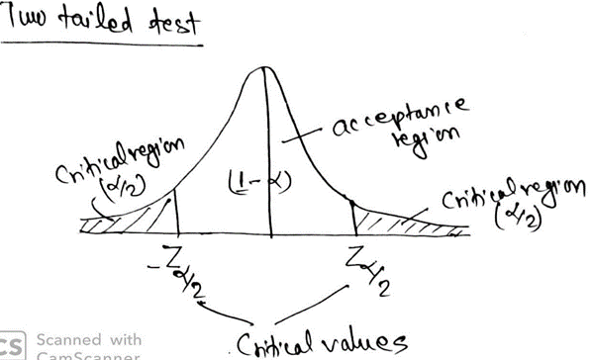
Critical value

Slide 8
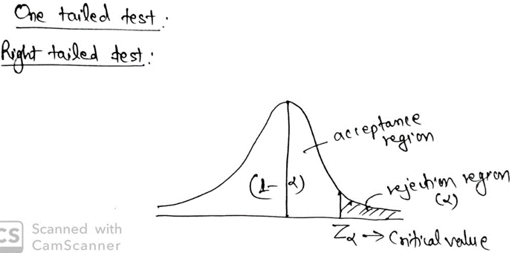

Slide 9
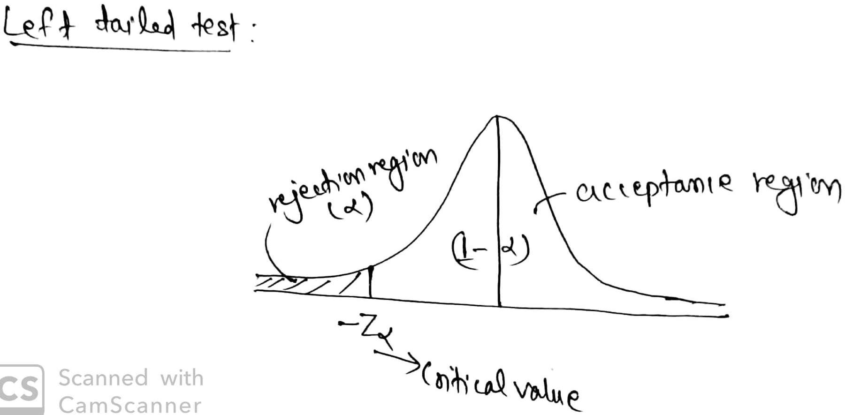

Slide 10
Degree of freedom
Degree of freedom refers to the no. of values in a sample that can be chosen freely i.e. the no. of independent variables which make up the statistics is known as degree of freedom. Thus in a set of ‘n’ sample observations usually the degree of freedom is n-1.
Identification of one tailed and two tailed test
If the direction of difference like at least, at most, increase, decrease, high, low, superior, inferior, more than, less than etc. are involved in the statement of hypothesis then we use one tailed test otherwise we use two tailed test.

